Slide 1
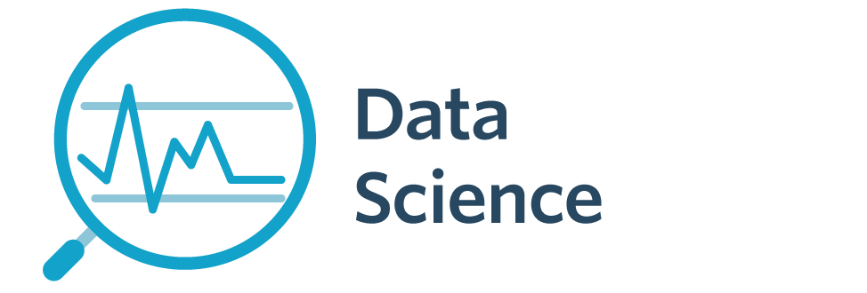

5005CEM Lecture 7b: Drivers of Big Data
School of Computing, Mathematics and Data Science Coventry University
5005CEM Data Science 2022/23 Semester 2

Slide 2
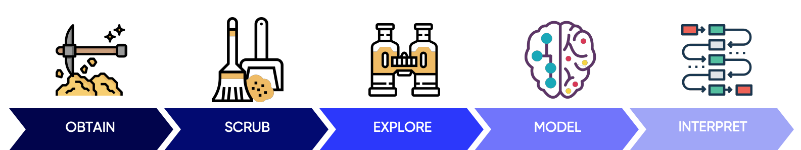
Recap
Data Science project lifecycle/pipeline/workflow
Big Tech: GAFA (Google, Apple, Facebook, Amazon)
Big Data: volume or velocity or variety (+veracity, …)
Multivariate data vs Big Data

Slide 3


Storage and Processors
Data storage (larger and cheaper hard drives, SSD, main memory)
March 2020: 1TB hard drive (< £35) [1TB = 1000 Gigabytes]
Moore’s Law (1965)
Computational power doubles approximately every two years

Slide 4
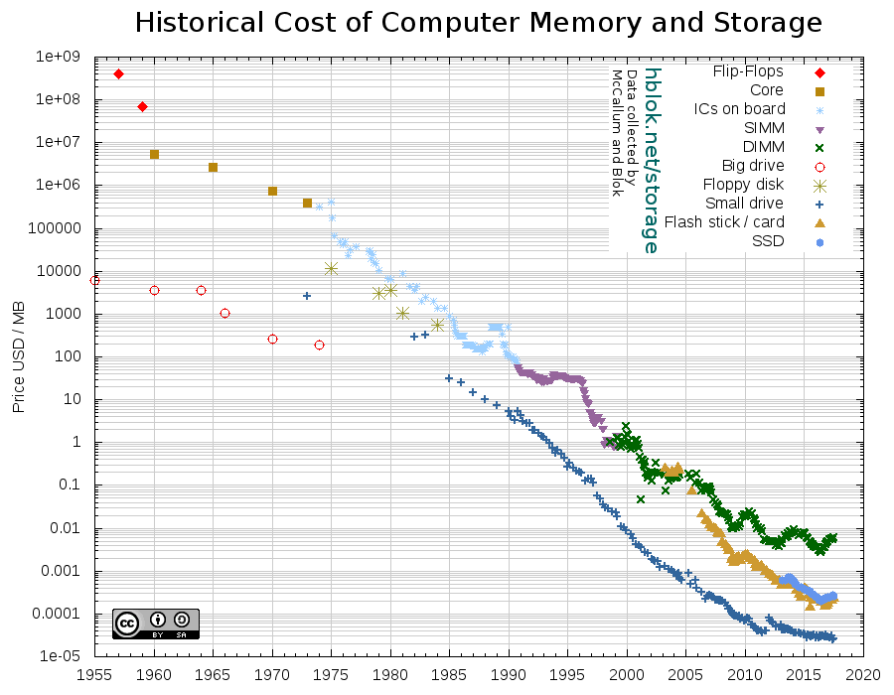
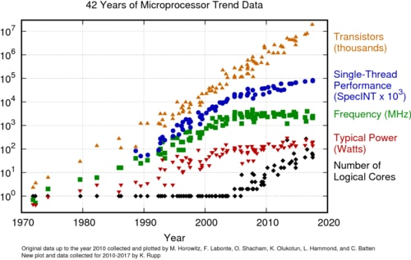
Moore’s Law
Notes:
Image: https://hblok.net/storage/
“Data expands to fill the space available for storage” (Tjomsland, 1980) variant of Parkinson’s Law
Moore’s Law (1965): https://en.wikipedia.org/wiki/Moore's_law
Image from: https://www.infoq.com/news/2020/04/Moores-law-55/

Slide 5
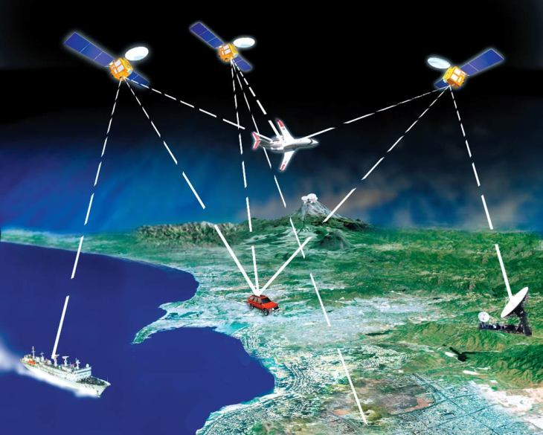
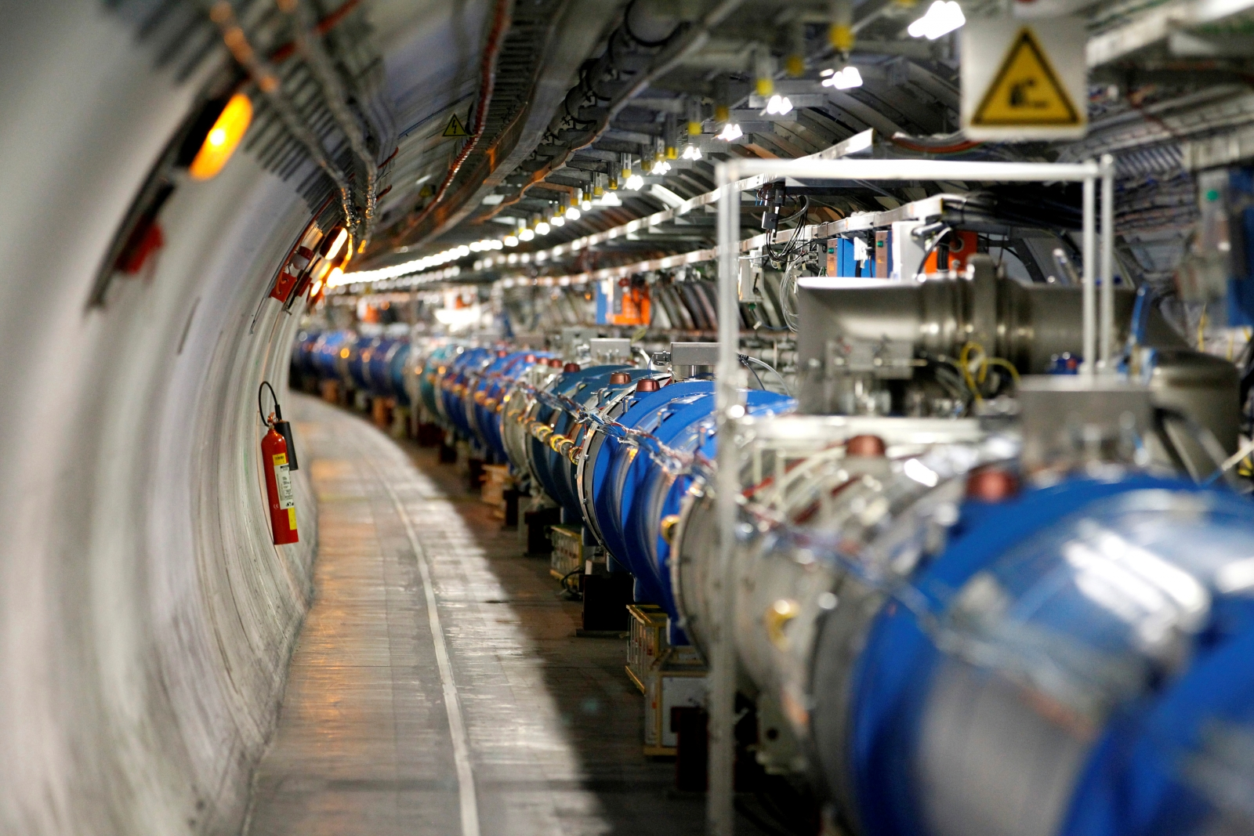
Streaming Data
Sensors and Internet of Things (IoT)
Mobile devices: collect personal and spatial data
L5 band GPS accurate to within 30cm (2018)
CERN Large Hadron Collider
Remote controlled and autonomous vehicles/drones

Slide 6
Big Data Companies
Internet of Things – Coca-Cola vending machine (1982)
World-Wide-Web (Berners-Lee, 1989)
Amazon (1995) – online bookstore
Google search (1998)
Facebook (2004)
Youtube (2005)
Netflix (streaming 2007) – originally DVD rental

Slide 7
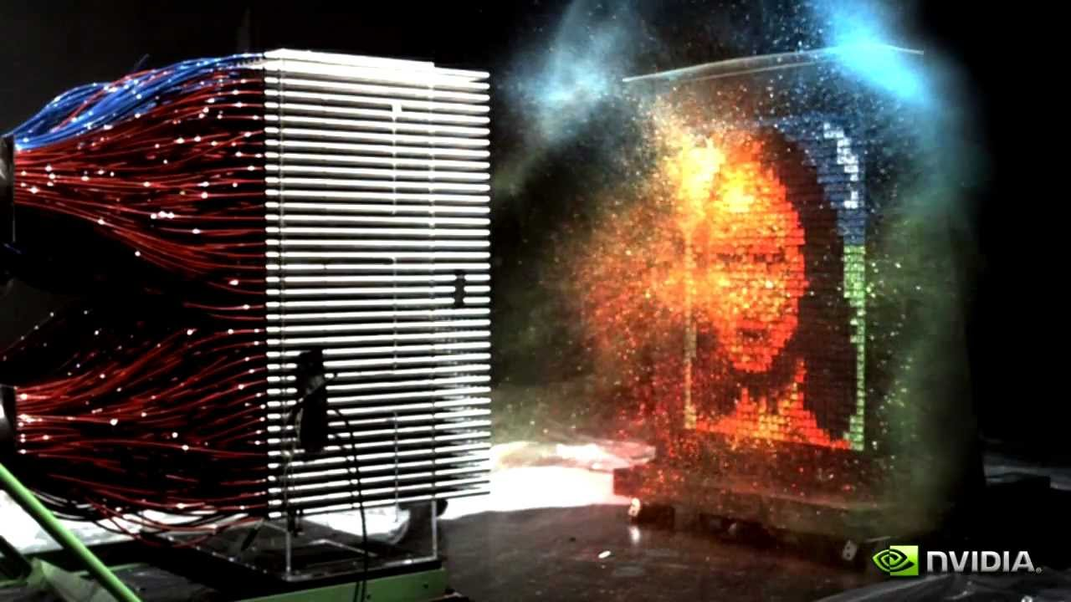

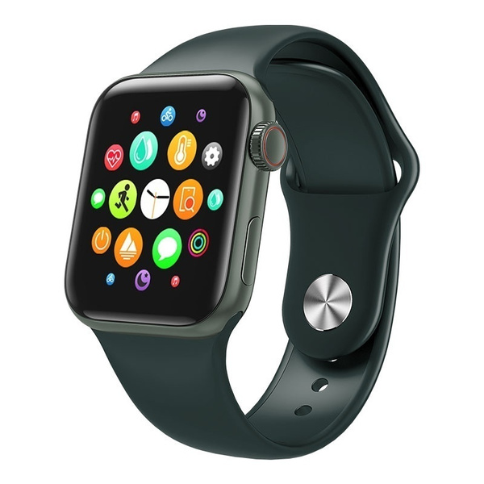
Advances in Hardware
Cloud computing and data centres (distributed computation/storage)
GPUs (Graphical Processing Units)
Make sure you watch the Mythbusters demo of CPU vs GPU
Smart watch
Quantum computing

Slide 8
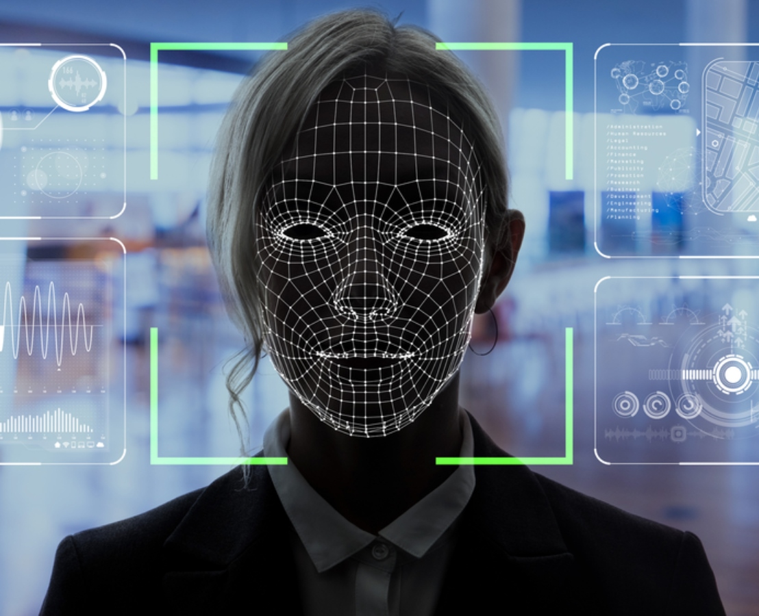
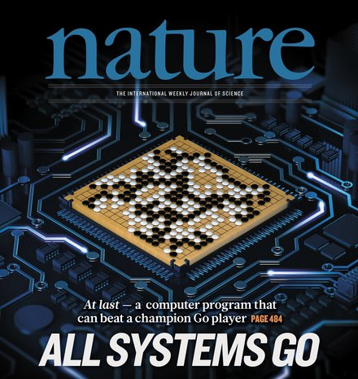
Advances in Machine Learning
Image processing
Speech recognition
IBM Watson (Jeopardy)
Artificial Intelligence for board games (Deep Blue, Alpha Go, Alpha Zero)
Face recognition (Deep Face)
Notes:
Reading: https://deepmind.com/research/case-studies/alphago-the-story-so-far
Reading: https://www.nature.com/articles/nature24270 (Nature, vol 550, 2017)

Slide 9
Drivers of Big Data
More data
Before – available samples only allowed simple models
Now – complex models can be trained because sample sets become huge (millions) and storage is cheap
More computational power
Before – complex models did not finish training
Now – models with several thousand parameters on millions of samples are possible
Scalability
Before – predictors for general case
Now – building personalised/individual models

Slide 10
Big Data Talent
Deep Analytical Talent
People with strong analytical skills and advanced training in machine learning and statistics.
Data Savvy Professionals
People with basic knowledge of machine learning and statistics, who can define key questions.
Technology and Data Enablers
People providing technical expertise (programming, database administration, etc) to support analytical projects.

Slide 11
Summary
Technology: processors and memory/storage
decreasing cost and increasing power/capacity/speed
streaming data (real-time)
sensors, social media interactions, transactions, history
Techniques: machine learning, data analytics, text, audio
Talent: people with different levels of skills/knowledge
Scalability
increasing amount of data and computational power
now possible to build personalised/individual models

Slide 12
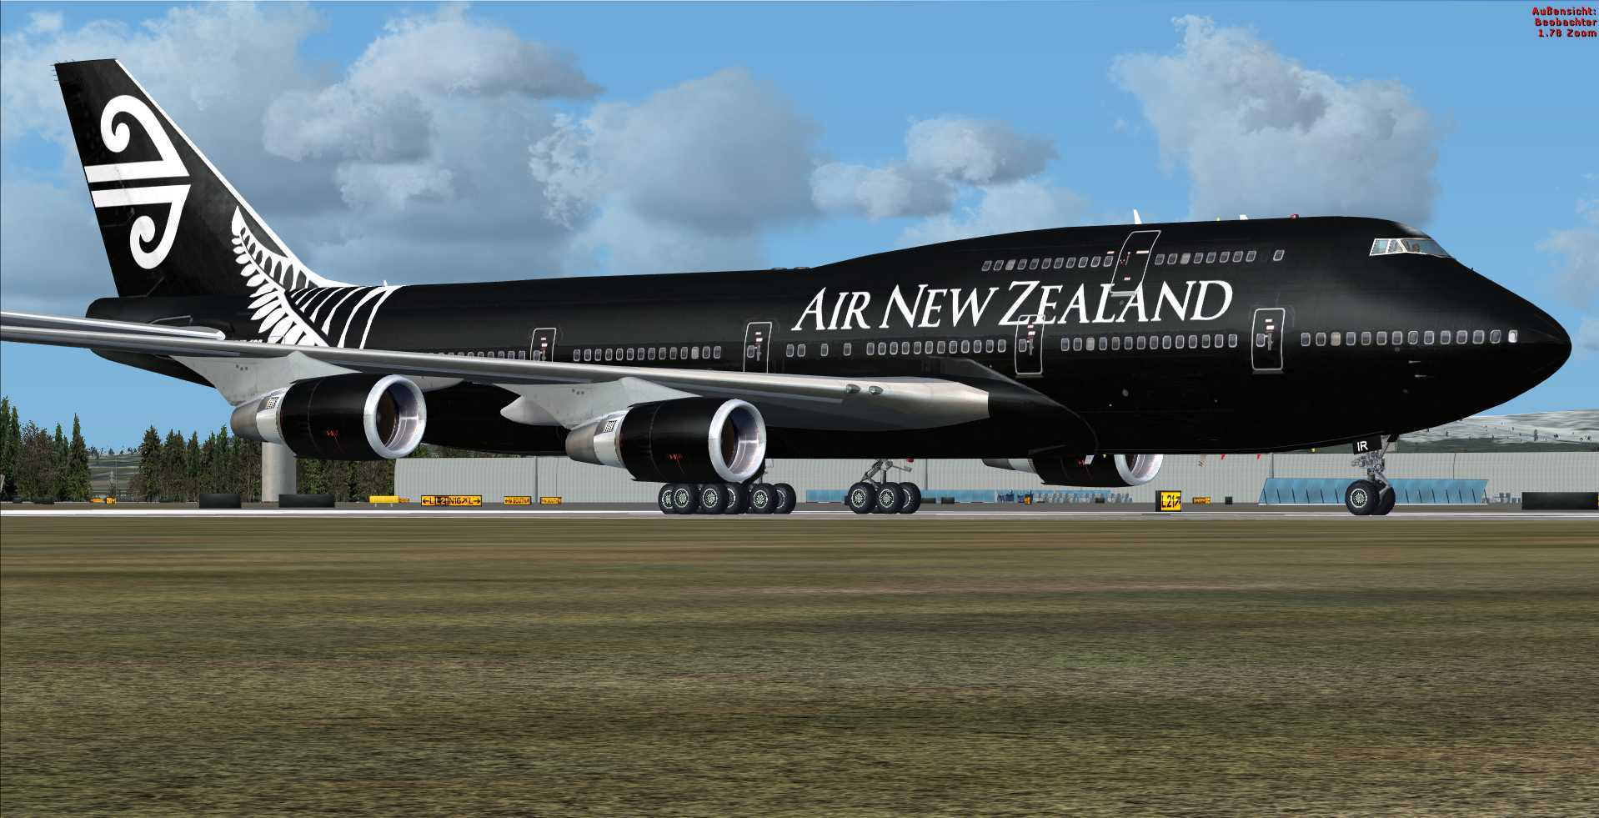
Class Discussion Questions
Why are the 3Ts considered as the "drivers" of Big Data?
(2) Discuss the following quote:
“If the Boeing 747 obeyed Moore's Law, it would travel a million miles an hour, it would be shrunken down in size, and a trip to New York would cost about five dollars.
— Nathan Myhrvold (former CTO at Microsoft)

